Slide 1
Teacher
Teaching Assistant
Facebook: Gia Long
Phone number: 0936362164
Gmail: gialong0308@gmail.com
Contact me if you have any questions or problems
Facebook: Hương Thảo
Phone number: 0383111106
Gmail: huongthaongo1009@gmail.com
Contact me if you have any questions or problems

Slide 2
Week 1: Introduction to Debate &
World School Debate Format
Coach:

Slide 3
Today’s content
Class overview.
Ice-breaking game
Some main crucial skills that you will practice mostly in this class including: Critical thinking, Public speaking and Team work
World School Debate format & speaker role

Slide 4
ICE- BREAKING GAME: FIND THE DIFFERENT WORDS
Blue
Pink
Red
FIND THE DIFFERENT WORDYou have to choose 1 character for yourself, any thing or anyone you like
Try to explain your decision

Slide 5
ICE- BREAKING GAME: FIND THE DIFFERENT WORDS
He
She
They
FIND THE DIFFERENT WORDYou have to choose 1 character for yourself, any thing or anyone you like
Try to explain your decision

Slide 6
ICE- BREAKING GAME: FIND THE DIFFERENT WORDS
Độc hại (Toxic)
Biến đổi khí hậu (Climate change)
Nền kinh tế (Economy)
FIND THE DIFFERENT WORDYou have to choose 1 character for yourself, any thing or anyone you like
Try to explain your decision

Slide 7
ICE- BREAKING GAME: FIND THE DIFFERENT WORDS
Ba
Mẹ
Chị gái
FIND THE DIFFERENT WORDYou have to choose 1 character for yourself, any thing or anyone you like
Try to explain your decision

Slide 8
ICE- BREAKING GAME: FIND THE DIFFERENT WORDS
Người giàu
Người nghèo
Người trung lưu
FIND THE DIFFERENT WORDYou have to choose 1 character for yourself, any thing or anyone you like
Try to explain your decision

Slide 9

ICE- BREAKING GAME
GAME RULES – AN AEROSTAT
You have to choose 1 character for yourself, any thing or anyone you like
Try to explain your decision

Slide 10
Why are we playing this game?
Debate is not about “Right” or “Wrong”, it’s about explaining and finding the best solution.
Always ask why
Everyone is in the debate matters.

Slide 11
SKILLS

Slide 12
Public Speaking

Slide 13
What is public speaking? Why do we need it?
Basically, it's a presentation that's given live before an audience. Public speeches can cover a wide variety of different topics. The goal of the speech may be to educate, entertain, or influence the listeners.
Public speaking is important in both business, education, and the public arena.

Slide 14
Teamwork

Slide 15
What is teamwork? Why do we need it?
REMEMBER: YOU CAN NEVER GO ALONE IN DEBATE
Teamwork is the collaborative effort of a group to achieve a common goal or to complete a task in the most effective and efficient way.

Slide 16
Critical thinking

Slide 17
What is critical thinking? Why do we need it?
Critical thinking is the analysis of facts to form a judgment. The subject is complex, and several different definitions exist, which generally include the rational, skeptical, unbiased analysis, or evaluation of factual evidence. Critical thinking is self-directed, self-disciplined, self-monitored, and self-corrective thinking.

Slide 18
Assumption about critical thinking
You have to win all the time by joining a fight
Dont trust anything or anyone
You are always right
You can be a critical thinker in few months
You have to rebut everyone to show your critical thinking

Slide 19
What can you do to practise your critical thinking?
Read book, articles or discuss with everyone about a topic. BE SELECTIVE
Be skeptical and Ask “Why” first.
Transform it into your knowledge.

Slide 20
World School Debate Format

Slide 21
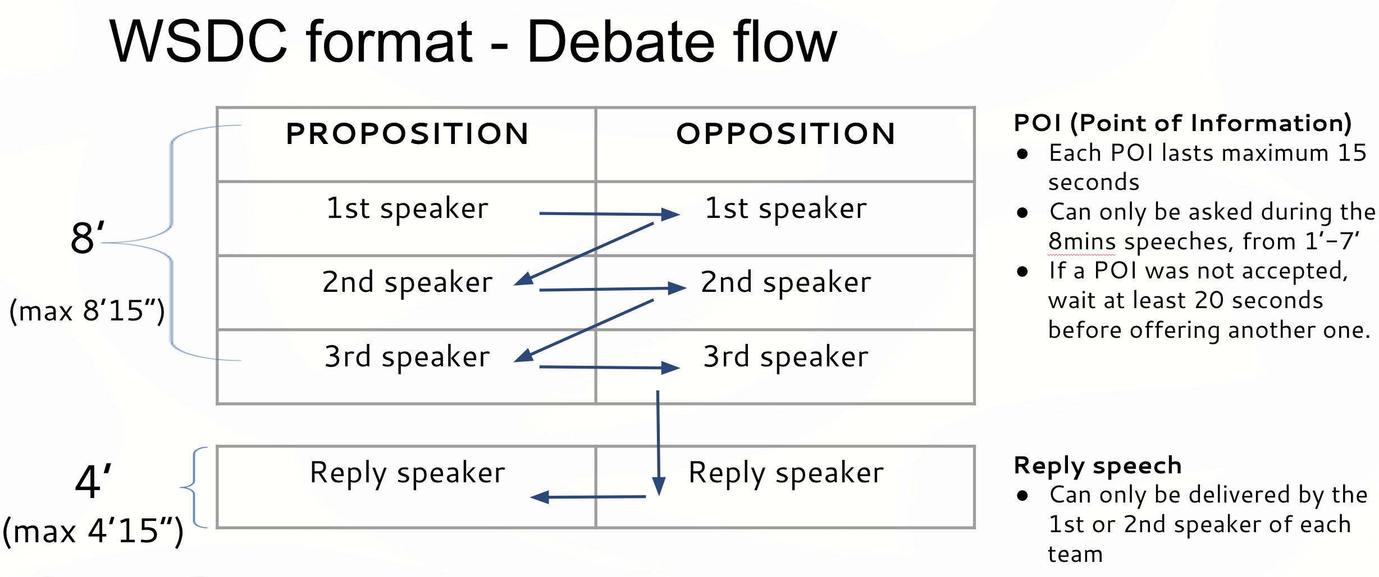
Notes:
3 speakers in a team
3-5 members in a team
30 - 1 hours of preparation
2 sides: Affirmative & Negative

Slide 22
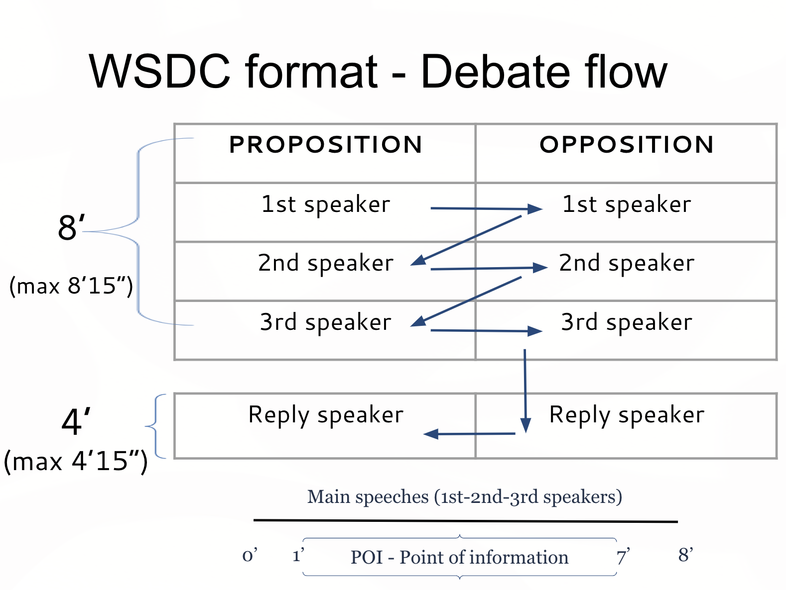
World School Debate Format
3 vs 3 (in a round)
A team comprises of 3-5 people who prepare together
Each team is allocated to either “proposition” or “opposition” on a motion
Each main speech last for 8 minutes.
Reply speech is 4 minutes.
Third speakers are not allowed to do reply speech.
Allowed to give Point of Information (POIs) in the main speech.
Notes:
3 speakers in a team
3-5 members in a team
30 - 1 hours of preparation
2 sides: Affirmative & Negative

Slide 23
Judging criteria
Content (40%) => WHAT you say in the debate
Style (40%) => HOW you say something in the debate (Note: NOT accent, use of cue cards, immutable characteristics e.g. pitch, tone; about word choice, pace, volume, speed, etc.)
Strategy (20%) => WHY you say something in the debate (e.g. motion interpretation, time allocation, consistency, POIs, dealing with the issues in the debate, etc.)

Slide 24
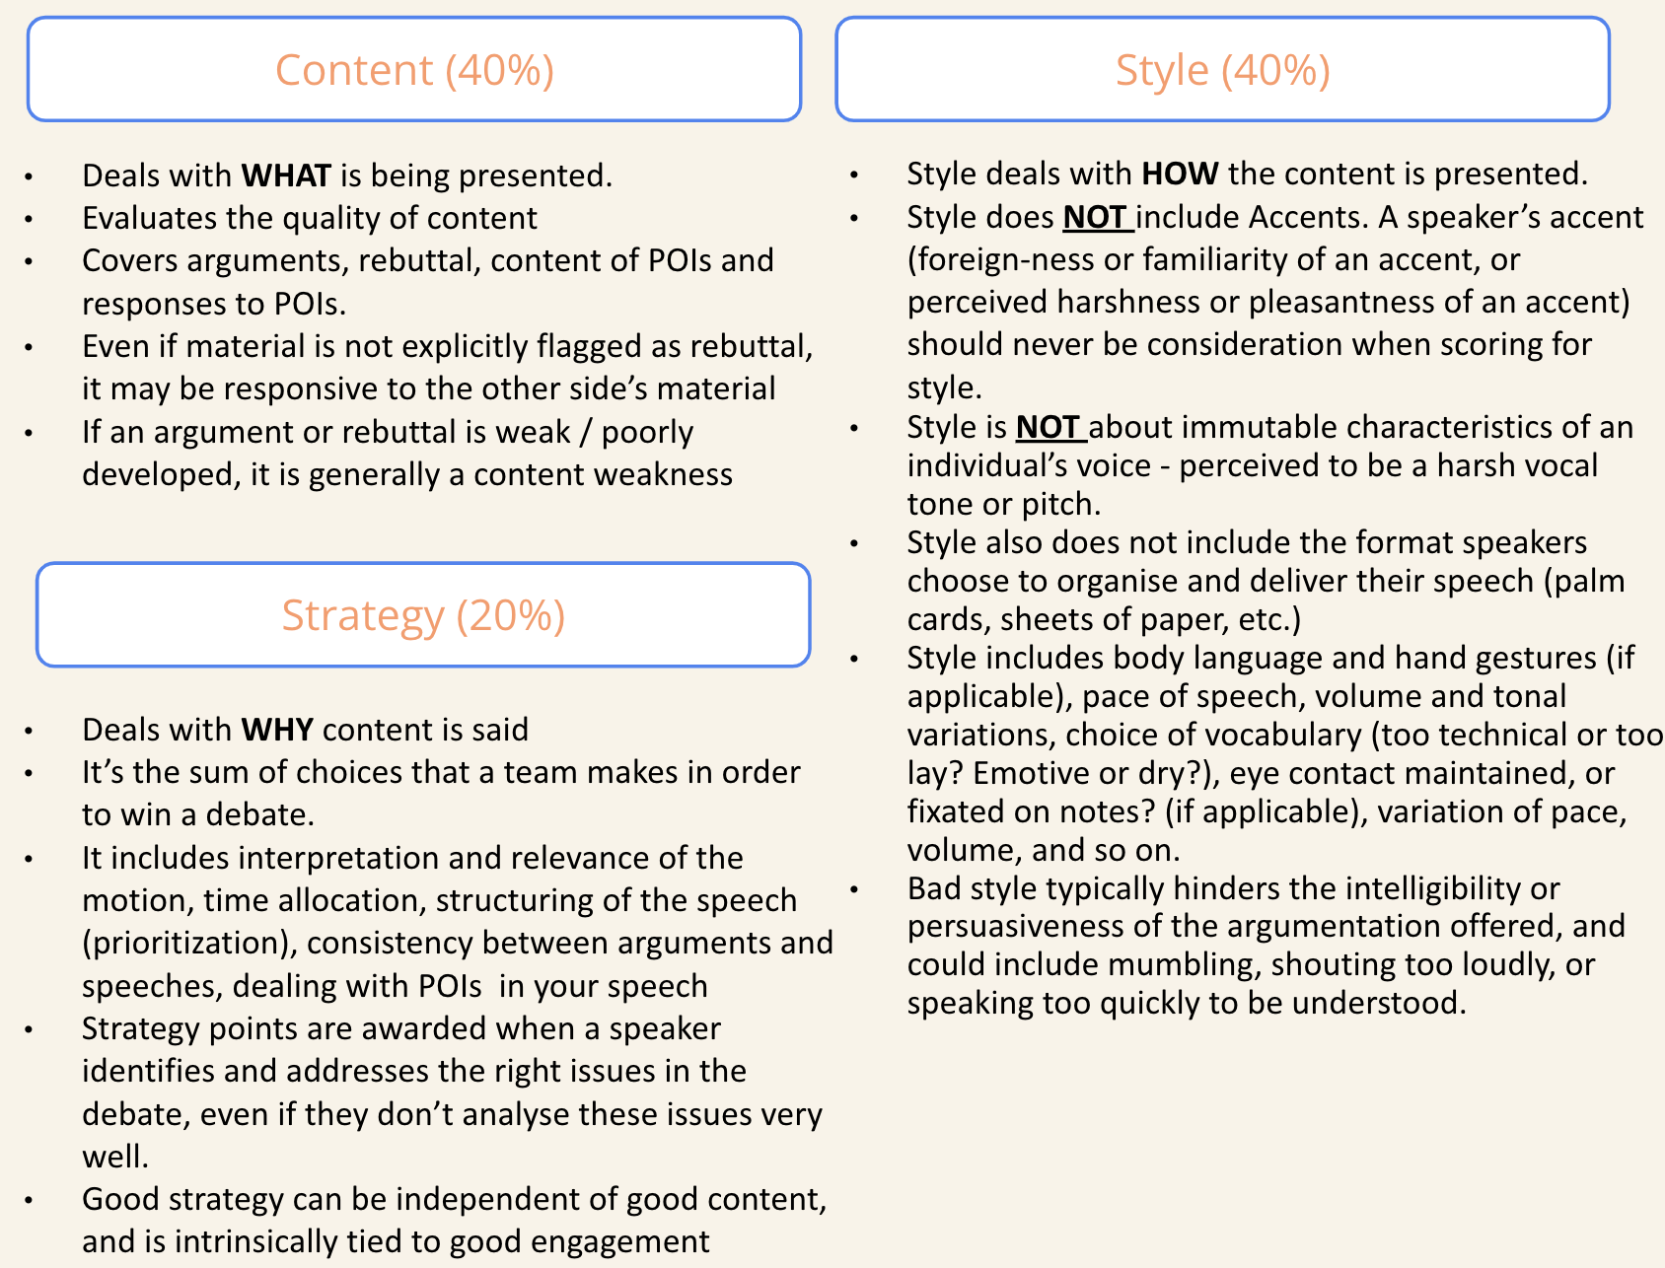
Judging criteria

Slide 25
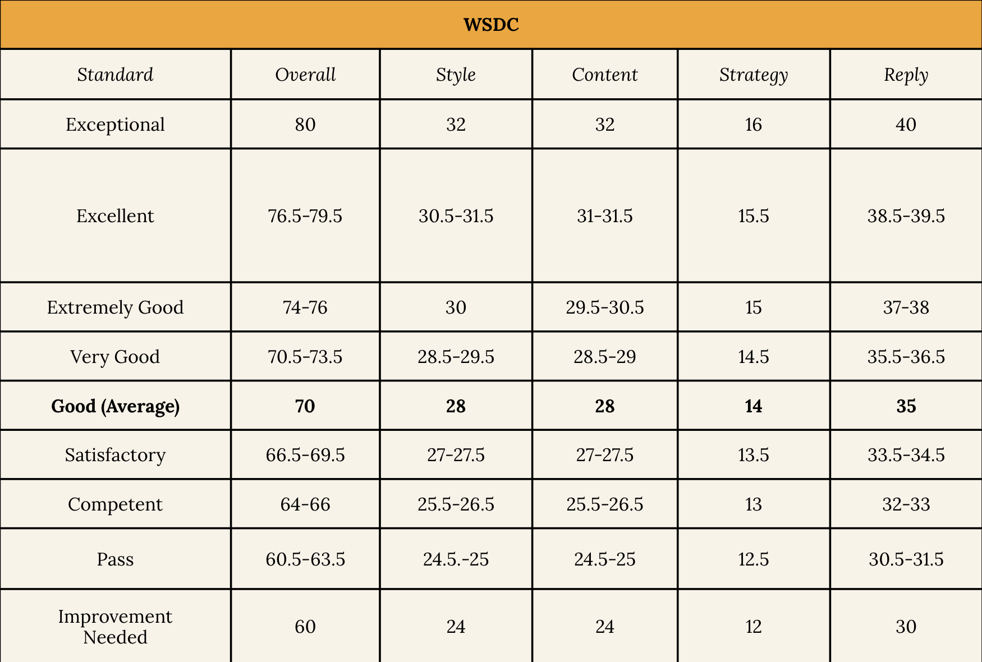

Slide 26
Other Debate format
Asian Parliamentary (content)
British Parliamentary (strategy)
World Scholar’s Cup (style)
World School is the best option for you.

Slide 27
Speaker’s Role

Slide 28
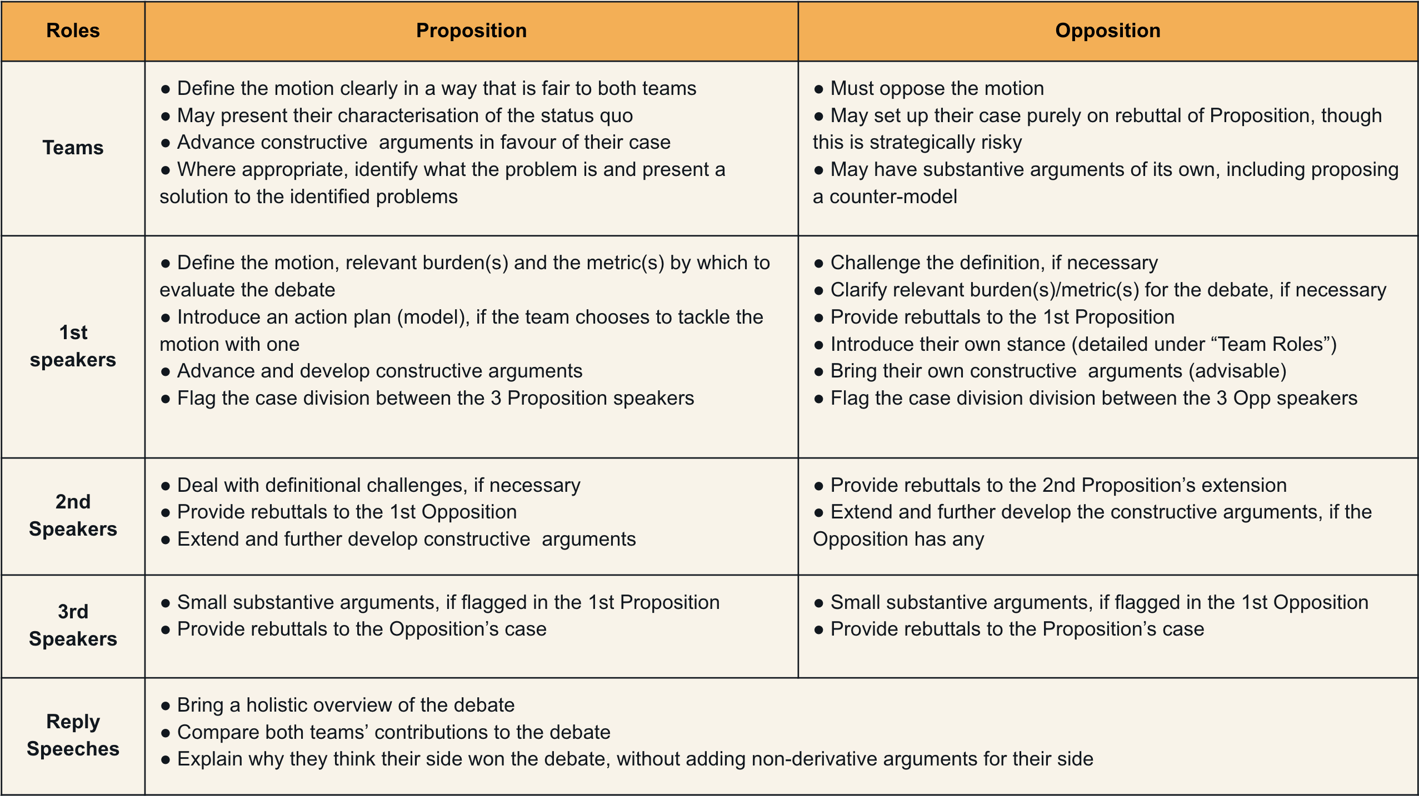
Speaker’s Role

Slide 29
First speaker of Proposition
First speaker of Opposition
1. Response to the case set-up:
Agree with the given context -> Prove that Prop cannot solve these problems.
Disagree with the given context -> Point out new problems.
2. Rebut against Prop’s argument(s)
3. Argument: At least ONE argument.
1. Context:
Identify the problem: Why do we have this motion?
Prove the problem by pointing out the consequences.
2. Definition
3. Goals/Metrics: Must be closely linked to the problem mentioned.
4. Argument: At least ONE argument.

Slide 30
Second speaker
1. Rebuttal:
Attacking rebuttal: Rebut to opponent team’s case.
Defensive rebuttal: Rebut to opponent’s rebuttals.
2. Extension:
Extend and/or improve your first speaker’s argument (s).
3. Argument:
Introduce all arguments left in your team’s case.
Notes:
wat

Slide 31
Third speaker
1. Rebuttal:
This is the MOST IMPORTANT part in a third speaker’s speech.
2. Defense/Extension:
Extend and/or defend your team’s arguments.
3. Summarise and Compare:
Summaries and compare between 2 teams’ cases to point out why your team should win the debate.
4. Conclude

Slide 32
Reply speaker
1. Point out your opponent’s mistakes in logical line
2. Compare and summarise to show judges what you have done better

Slide 33
Conclusion
What is debate?
Skills
World School Debate Format
Speaker roles

Slide 34
Thank you!

